Slide 1

Listings123 Succesfull Host Traits
(Data-based evidence on what makes hosts successful)

Slide 2
Problem
Listings123 wants to expand the business to new cities through a marketing campaign to attract new hosts and guests. In order to reach this goal, the company needs to gather data-based traits on what makes a successful host.
Research Methods
In order to gather recommendations, Exploratory Data Analysis was used to find what traits makes a successful host. The following were found:
Exceptionally high Revenue in some certain cities
High Number of Reviews equals more Revenue
High Number of Amenities equals more Revenue

Slide 3
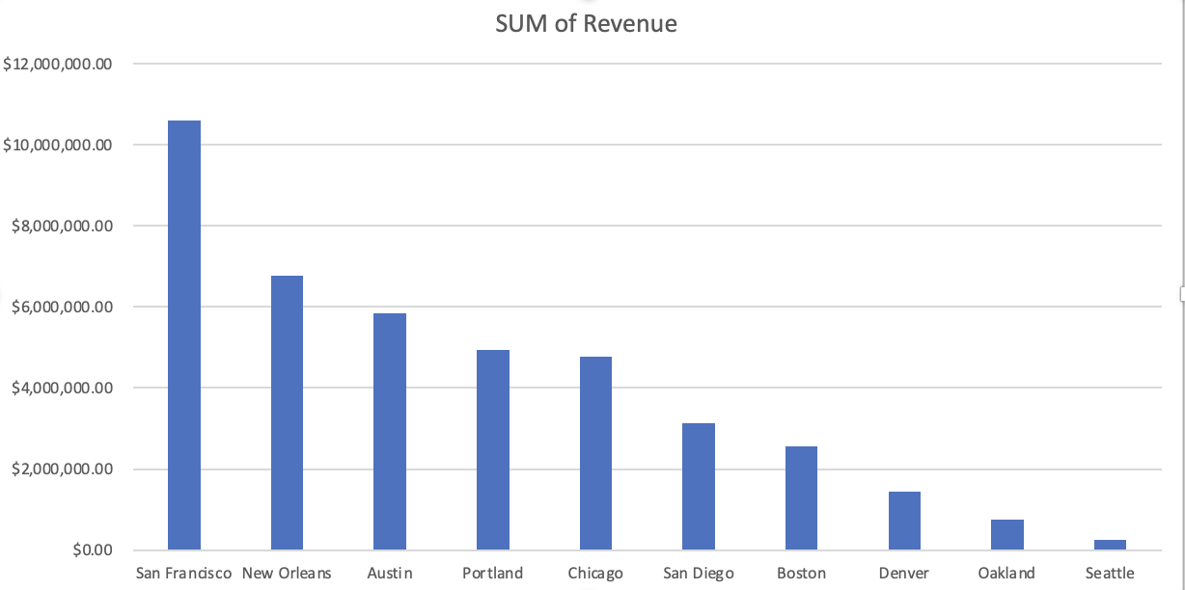
Trait 1. Relationship between City and Revenue
Listings in San Francisco or in similar cities have a higher revenue
Listings in San Francisco made $3,823,140 more than the next highest earning city New Orleans
This data points suggests that listings located in such cities generate more revenue thus it is better to list properties there.

Slide 4
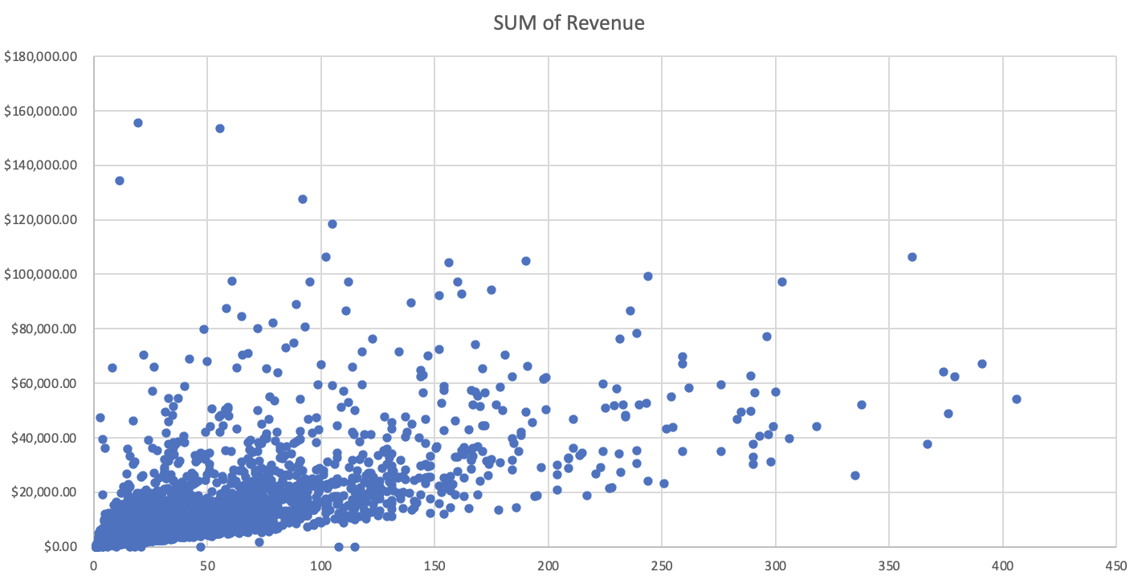
Trait 2. Number of Reviews
There is a steady increase in Revenue for listings with higher number of Reviews.
Guests seem to trust listings with more reviews, data suggests that listings with high number of reviews generate more Revenue
Making sure listings are receiving reviews after hosting a guest can incur in higher revenue for those listings

Slide 5
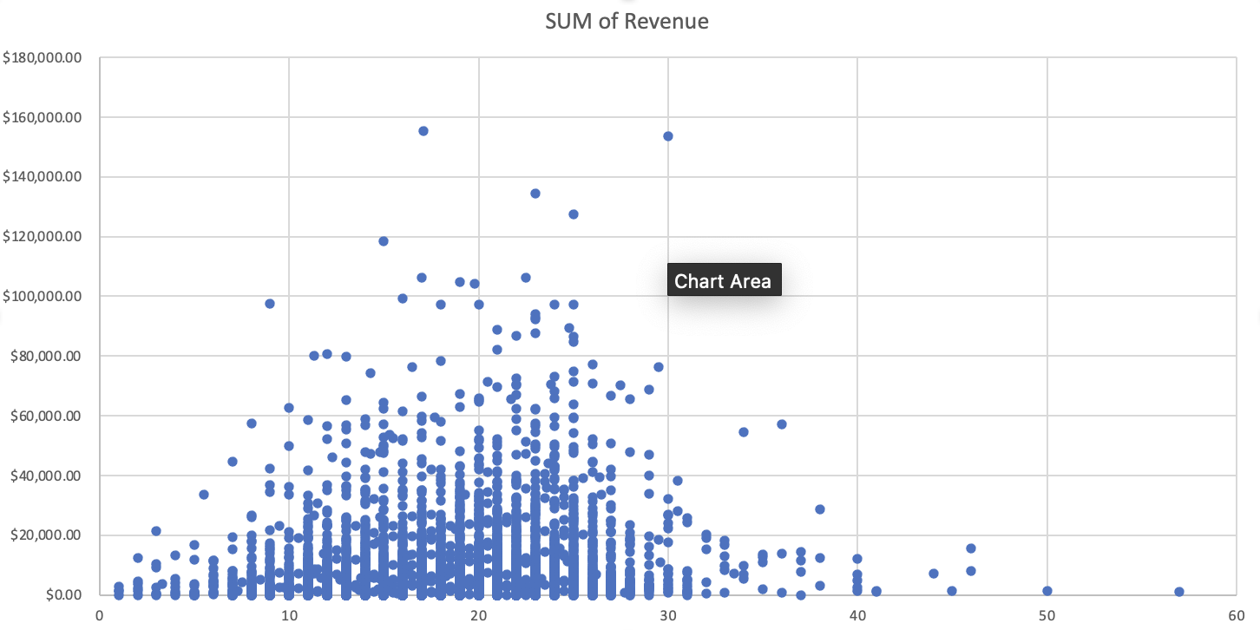
Trait 3. Number of Amenities
Data suggests that Amenities offered can increase Revenue
Guests to like listings that host a variety of Amenities for their enjoyment
This suggests educating hosts on the importance of having a listing with multiple Amenities

Slide 6
Next Steps
In order to grow listings needs to attract new hosts and expand to new cities. A nationwide marketing campaign is essential for the promotion of the company and showing the beneﬁts to both hosting and being a guest.
In order to take the most advantage of the marketing campaign it should focus on the following:
Training new hosts in high-earning cities such as : San Francisco, New Orleans and Austin
Remind guests to review listings after their stay
Educating new and existing hosts on the importance of having multiple amenities in a listing
Resources needed
Funding for launching Listing123 nationwide marketing campaign

